Slide 1
CHAPTER 18
TESTING CONVENTIONAL APPLICATIONS

Slide 2
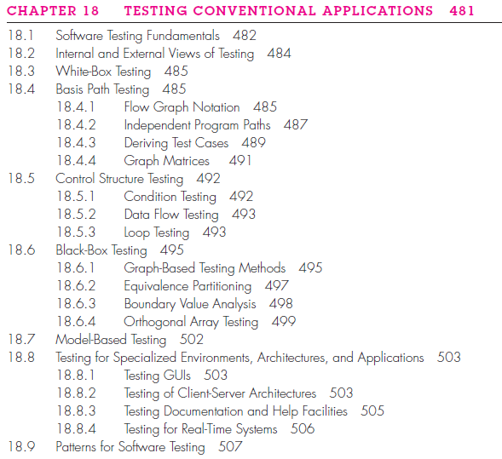
Content

Slide 3
18.1 SOFTWARE TESTING FUNDAMENTALS
Goal of testing is to finding the most errors with a minimum of effort.
Testability “Software testability is simply how easily [a computer program] can be tested.” The following characteristics lead to testable software.
Operability. “The better it works, the more efficiently it can be tested.”[designed and implemented with quality in mind]
Observability. “What you see is what you test.” Incorrect output is easily identified. Internal errors are automatically detected and reported.[Source code is accessible]
Controllability. “The better we can control the software, the more the testing can be automated and optimized.”[combination of input, formats are consistent and structured]

Slide 4
Decomposability. “By controlling the scope of testing, we can more quickly isolate problems and perform smarter retesting.”[independent modules testing]
Simplicity. “The less there is to test, the more quickly we can test it.”
[functional simplicity, structural simplicity, code simplicity]
Stability. “The fewer the changes, the fewer the disruptions to testing.”
Understandability. “The more information we have, the smarter we will test.”[architectural design, dependencies, components]

Slide 5
Test Characteristics
A good test has a high probability of finding an error.
A good test is not redundant [Every test should have a different purpose]
A good test should be “best of breed”[more accurate according situation]
A good test should be neither too simple nor too complex

Slide 6
18.2 INTERNAL AND EXTERNAL VIEWS OF TESTING
Any engineered product can be tested in one of two ways:
(1) Knowing the specified function that a product has been designed to perform, tests can be conducted that demonstrate each function is fully operational while at the same time searching for errors in each function. (2) Knowing the internal workings of a product, tests can be conducted to ensure that “all gears mesh,” that is, internal operations are performed according to specifications and all internal components have been adequately[sufficient] exercised. The first test approach takes an external view and is called black-box testing. The second requires an internal view and is termed white-box testing.

Slide 7
18.3 WHITE-BOX TESTING
White-box testing, sometimes called glass-box testing, is a test-case design philosophy that uses the control structure described as part of component-level design to derive test cases.
(1) guarantee that all independent paths within a module have been exercised at least once.
(2) exercise all logical decisions on their true and false sides,
(3) execute all loops at their boundaries and within their operational bounds
(4) exercise internal data structures to ensure their validity.

Slide 8
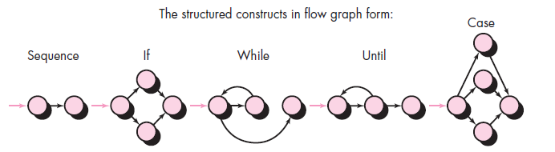
18.4 BASIS PATH TESTING
Basis path testing is a white-box testing technique. The basis path method enables the test-case designer to derive a logical complexity measure of a procedural design and use this measure as a guide for defining a basis set of execution paths.
18.4.1 Flow Graph Notation: simple notation for the representation
of control flow, called a flow graph (or program graph).
Each circle, called a flow graph node, represents one or more procedural statements. A sequence of process boxes and a decision diamond can map into a single node. The arrows on the flow graph, called edges or links, represent flow of control. Areas bounded by edges and nodes are called regions.

Slide 9
Fig 18.2 for more detailed flow chart and flow graph
When compound conditions are encountered in a procedural design, the generation of a flow graph becomes slightly more complicated. A compound condition occurs when one or more Boolean operators (logical OR, AND, NAND, NOR) is present in a conditional statement.
18.4.2 Independent Program Paths
An independent path is any path through the program that introduces at least one new set of processing statements or a new condition. When stated in terms of a flow graph, an independent path must move along at least one edge that has not been traversed before the path is defined.
Notes:
Separate node is created for each of the conditions a and b in the statement IF a OR b. Each node that contains a condition is called a predicate node.
Cyclomatic complexity is a useful metric for predicting those modules that are likely to be error prone. Use it for test planning as well as test-case design.

Slide 10
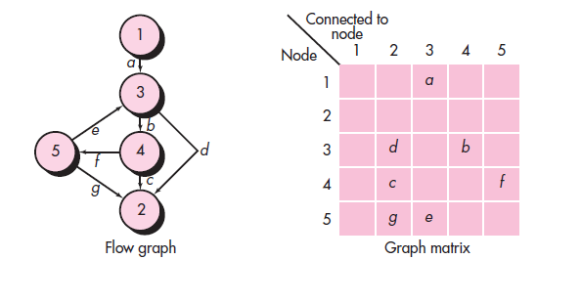
18.4.3 Deriving Test Cases: The following steps can be applied to derive the basis set:
Using the design or code as a foundation, draw a corresponding flow graph.
Determine the cyclomatic complexity of the resultant flow graph.
Determine a basis set of linearly independent paths.
Prepare test cases that will force execution of each path in the basis set.
18.4.4 Graph Matrices : A data structure, called a graph matrix, can be quite useful for developing a software tool that assists in basis path testing.

Slide 11
18.5 CONTROL STRUCTURE TESTING
The basis path testing technique is one of a number of techniques for control structure testing. These broaden testing coverage and improve the quality of white-box testing.
18.5.1 Condition Testing
Condition testing is a test-case design method that exercises the logical conditions contained in a program module. A simple condition is a Boolean variable or a relational expression.
E1 <relational-operator> E2 where E1 and E2 are arithmetic expressions and <relational-operator>
A compound condition is composed of two or more simple conditions, Boolean operators(OR,AND,NOT), and parentheses.
Types of errors in a condition include Boolean operator errors (incorrect/missing/extra Boolean operators), Boolean variable errors, Boolean parenthesis errors, relational operator errors, and arithmetic expression errors.
The condition testing method focuses on testing each condition in the program to ensure that it does not contain errors.

Slide 12
18.5.2 Data Flow Testing
The data flow testing method selects test paths of a program according to the locations of definitions and uses of variables in the program.
Data flow testing approach, assume that each statement in a program is assigned a unique statement number and that each function does not modify its parameters or global variables.
18.5.3 Loop Testing
Loop testing is a white-box testing technique that focuses exclusively on the validity of loop constructs.
Four different classes of loops can be defined: simple loops, concatenated loops(compound), nested loops(loop within loop), and unstructured loops(complicated redesign)……..[Fig 18.7]

Slide 13
18.6 BLACK-BOX TESTING
Black-box testing, also called behavioral testing, focuses on the functional requirements of the software.
Black-box testing attempts to find errors in the following categories: (1) incorrect or missing functions, (2) interface errors, (3) errors in data structures or external database access, (4) behavior or performance errors, and (5) initialization and termination errors.
18.6.1 Graph-Based Testing Methods
Testing begins by creating a graph of important objects and their relationships then devising a series of tests that will cover the graph so that each object and relationship is exercised and errors are uncovered.
creating a graph—a collection of nodes that represent objects, links that represent the relationships between objects, node weights that describe the properties of a node (e.g., a specific data value or state behavior), and link weights that describe some characteristic of a link.
A directed link (represented by an arrow) indicates that a relationship moves in only one direction. A bidirectional link, also called a symmetric link, implies that the relationship applies in both directions. Parallel links are used when a number of different relationships are established between graph nodes.

Slide 14
18.6.2 Equivalence Partitioning
Equivalence partitioning is a black-box testing method that divides the input domain of a program into classes of data from which test cases can be derived.
18.6.3 Boundary Value Analysis
Boundary value analysis leads to a selection of test cases that exercise bounding values.
18.6.4 Orthogonal Array Testing
The orthogonal array testing method is particularly useful in finding region faults—an error category associated with logic within a software component.

Slide 15
18.7 MODEL-BASED TESTING
Model-based testing (MBT) is a black-box testing technique that uses information contained in the requirements model as the basis for the generation of test cases.The MBT technique requires five steps:
1. Analyze an existing behavioral model for the software or create one.[respond, sequence, UML state diagram, verify accuracy and consistency]
2. Traverse the behavioral model and specify the inputs that will force the software to make the transition(cause of) from state to state.
3. Review the behavioral model and note the expected outputs as the software makes the transition from state to state.
4. Execute the test cases.
5. Compare actual and expected results and take corrective action as required.

Slide 16
18.8 TESTING FOR SPECIALIZED ENVIRONMENTS, ARCHITECTURES, AND APPLICATIONS
18.8.1 Testing GUIs
Graphical user interfaces (GUIs) will present you with interesting testing challenges . Creation of the user interface has become less time consuming and more precise. Tests that address specific data and program objects that are relevant to the GUI(automated tools).
18.8.2 Testing of Client-Server Architectures
Testing of client-server software occurs at three different levels: (1) Individual client applications are tested in a “disconnected” mode; the operation of the server and the underlying network are not considered. (2) The client software and associated server applications are tested in concert, but network operations are not explicitly exercised. (3) The complete client-server architecture, including network operation and performance, is tested.
Application function tests(functionality of client applications is tested), Server tests(overall response time and data throughput), Database tests(data are properly stored, updated, and retrieved), Transaction tests(correctness of processing and also on performance issues), Network communication tests(Network security tests).

Slide 17
18.8.3 Testing Documentation and Help Facilities
Documentation testing can be approached in two phases. The first phase, technical review , examines the document for editorial clarity. The second phase, live test, uses the documentation in conjunction with the actual program.
ensure that documented behavior and actual behavior coincide.
18.8.4 Testing for Real-Time Systems
In addition, the intimate relationship that exists between real-time software and its hardware environment can also cause testing problems. Software tests must consider the impact of hardware faults on software processing. Such faults can be extremely difficult to solve.Overall four-step strategy can be proposed:
Task testing (test each task independently errors in logic and function)
Behavioral testing(behavior as a consequence of external events)
Inter-task testing(tasks that communicate)
System testing(full range of system tests are conducted)

Slide 18
18.9 PATTERNS FOR SOFTWARE TESTING
Testing patterns describe common testing problems and solutions that can assist you in dealing with them.
Dozens of testing patterns have been proposed in the literature.

